Slide 1
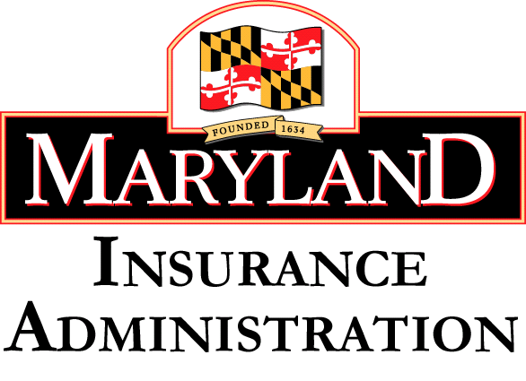
Protecting Yourself Against Insurance Fraud April 26, 2018
Joe Smith, Assistant Chief, Civil Fraud Unit
Joe.Smith@Maryland.gov

Slide 2
Agenda: Protecting Yourself Against Insurance Fraud
Introduction to Insurance Fraud
Auto Insurance Fraud
Homeowner’s Insurance Fraud
Fraud Watch – Contractors
Certificates of Insurance
Fraud Watch – Public Adjusters

Slide 3
Maryland Insurance Administration
The Maryland Insurance Administration (MIA) is the state agency that regulates insurance in Maryland. The MIA:
Licenses insurance companies and producers
Examines the business practices of licensees to ensure compliance
Monitors solvency of insurance companies
Reviews/approves insurance policy forms and rates
Investigates consumer and provider complaints and allegations of fraud

Slide 4
Insurance Fraud Division
Civil Insurance Fraud
Criminal Insurance Fraud

Slide 5
What is Insurance Fraud?
Insurance fraud occurs when someone deceives an insurance company or a consumer in order to make money.
Insurance fraud is knowingly and willfully presenting a false or fraudulent insurance application or claim, a crime subject to fines and jail time.
Insurance fraud can be divided into two major categories:
1. Fraud by an insurance entity, and
2. Fraud against an insurance entity.

Slide 6
How does Insurance Fraud impact you?
The FBI says insurance fraud costs the average US family between $400 and $700 a year – in the form of increased premiums.¹
When insurance companies lose money due to fraud, they pass these costs on to their policyholders in terms of higher rates and premiums.

Slide 7
Fraud by an Insurance Entity
Fraud by an insurance agent, insurance company employee or someone posing as an authorized representative of an insurance company.
Fake/False Documents
False Statements
Pocketing Premiums
Selling Unauthorized Insurance
Notes:
Examples Include:
• Fake/False Documents – An insurance agent or insurer issues fake policies, certificates, insurance identification cards, etc…
• False Statements – A producer or consumer makes a false statement in the sale or issuance of a policy, or on the application itself.
• Pocketing Premiums – An insurance agent or insurer pockets the premium, and then issues a phony policy or none at all.
• Selling Unauthorized Insurance – It is illegal to sell an unauthorized insurance product.
Policies sold in Maryland must be approved by the Maryland Insurance Administration.

Slide 8
Fraud by an Insurance Entity
Premium Diversion – the embezzlement of insurance premiums
Churning – the illegal practice of unnecessarily replacing existing life insurance for the purpose of earning commissions
Notes:
Premium Diversion
Premium diversion is the embezzlement of insurance premiums.
Generally, an insurance agent fails to send premiums to the underwriter and instead keeps the money for personal use.
Another common premium diversion scheme involves selling insurance without a license, collecting premiums and then not paying claims.
Churning
An illegal practice where insurance agents unnecessarily replace existing life insurance for the purpose of earning additional commissions.
Your agent offers to sell you a policy with a larger death benefit than your current policy. The agent says you can buy the new policy at no additional cost. What your agent doesn't say is by switching to a new policy, you are using the cash value of the old policy - money you could have used to address many financial needs.

Slide 9
Fraud against an Insurance Entity
Fraud by individuals, policyholders, medical providers or other service providers against an insurance company to receive money by filing a false claim or inflating a legitimate one
Arson for profit
Disaster Fraud
Creating a fraudulent claim
Exaggerated Claims (overstating amount of loss)
Medical Fraud (Medical Mills)
False Health Claims
Notes:
Arson for Profit – A business, home, or vehicle is intentionally set on fire by the owner or someone acting on behalf of the owner to collect insurance money.
• Disaster Fraud – An individual persuades a disaster victim to claim more damages than actually occurred.
• Creating a Fraudulent Claim – staging or intentionally causing an auto accident; staging slipand-fall accidents; claiming an injury occurred on the job when it did not; falsely claiming a foreign object in a food; phony burglary or theft.
Exaggerated Claims (Overstating the Amount of Loss) – These can include: inflating bodily injuries from an auto accident or work-related injury; inflating the value of items taken during a burglary or theft; inflating a physical damage claim from a minor fender bender; and medical providers inflating billing or upcoding of medical procedures.
• Medical Fraud (“Medical Mills”) – Medical providers bill insurers for services they do not provide or inflate the bills for services. These scams frequently are connected to automobile accidents or disability claims. • False Health Claims – Knowingly making a false statement or representation in a health insurance claim or application, by a patient or by a provider, to an insurance company or to a state health plan or program.

Slide 10
Auto Insurance Fraud
Common staged accident schemes:
Drive-down
Hit & Run
Sideswipe
Swoop and Squat
Notes:
Drive-Down – A driver waves on another driver, indicating it’s O.K. to proceed, and then intentionally hits the passing car.
• Hit & Run – Using a pre-damaged vehicle, criminals claim they were in an accident and can’t identify the other driver, often calling police to verify.
• Sideswipe – A driver in the inside lane of a dual left-turn lane in a busy intersection drifts into the outer lane, intentionally forcing a collision.
• Swoop & Squat – This scam occurs when the vehicle you are following is suddenly passed by another vehicle that “swoops” in front of it. This causes the vehicle in front of you to stop abruptly, or “squat.” As a result, you are unable to avoid a collision

Slide 11
Auto Insurance Fraud
Staged accidents with fake injuries
Jump-in passengers
Exaggerated injury claims
Vehicle damage enhanced after the accident
Claims for pre-existing damage
Vehicle garaged in another location
Falsified claims that occurred before policy period began
False report of hit-while-parked
Notes:
Staged auto accidents with faked reports of injuries
Jump-in passengers who are added to the claim and/or accident report but were not in the vehicle at the time of the accident
Exaggerated injury claims with prolonged treatment
False reports of auto theft
Vehicle damage enhanced after the accident
Vehicle damage claims for pre-existing damage
Vehicle is garaged in another town than listed on the policy
Reports of falsified claims that occurred before the policy period began
False report of a hit-while-parked accident

Slide 14
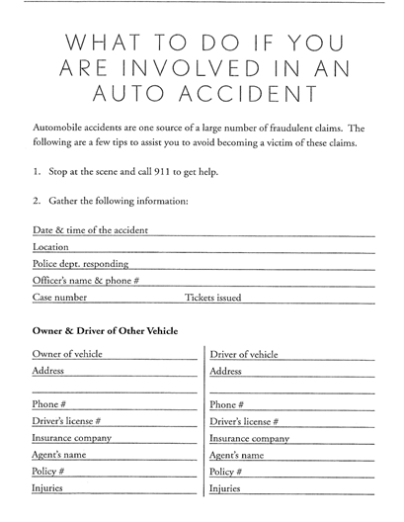
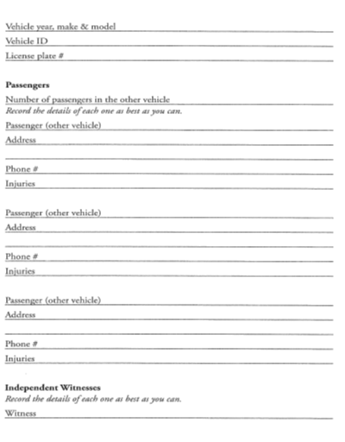

Slide 15
Protect Yourself
Notify your insurance company of the accident as soon as possible.
Make them aware of any suspicions you have relating to the facts of the accident.

Slide 16
Homeowners Insurance Fraud
False reports of theft in home or auto
Exaggerated claims
Intentional damage
Inflating estimates or bills to cover policy deductible
Concealing residence is used as a rental
Notes:
False report of theft of property in a home or vehicle
Exaggerating the value of stolen items or submitting falsified receipts for items reported
Intentionally damaging property
Inflating the estimate or bill to cover the policy deductible
Concealing that the residence is used as a rental

Slide 17
Homeowners Insurance

Slide 18
Medicare Fraud
Protect your Medicare and Social Security number.
Remember that nothing is ever “free.”
Ask questions.
Educate yourself about Medicare.
Use a calendar to record appointment and tests dates. Review your statements.
Notes:
Do protect your Medicare Number (on your Medicare card) and your Social Security Number (on your Social Security card). Treat your Medicare card like it's a credit card.
Do remember that nothing is ever "free." Don't accept offers of money or gifts for free medical care.
Do ask questions. You have a right to know everything about your medical care including the costs billed to Medicare.
Do educate yourself about Medicare. Know your rights and know what a provider can and can't bill to Medicare.
Do use a calendar to record all of your doctor's appointments and what tests or X-rays you get. Then check your Medicare statements carefully to make sure you got each service listed and that all the details are correct. If you spend time in a hospital, make sure the admission date, discharge date, and diagnosis on your bill are correct.

Slide 19
Tips to prevent Medicare Fraud
Be wary of providers who tell you that the item or service isn’t covered, but they “know how to bill Medicare.”
Make sure you understand how a plan works before signing up.
Check your medications before you leave the pharmacy.
Report suspected instances of fraud.
Notes:
Do be wary of providers who tell you that the item or service isn't usually covered, but they "know how to bill Medicare" so Medicare will pay.
Do make sure you understand how a plan works before you join.
Do always check your pills before you leave the pharmacy to be sure you got the correct medication, including whether it's a brand or generic and the full amount. If you don’t get your full prescription, report the problem to the pharmacist.
Do report suspected instances of fraud.

Slide 20
Tips to prevent Medicare Fraud
Don’t allow anyone except your doctor and Medicare providers to review your medical records.
Don’t accept medical supplies from a door-to-door salesman. Medicare and Medicaid don’t send unsolicited representatives to your home.
Notes:
Don't allow anyone, except your doctor or other Medicare providers, to review your medical records or recommend services.
Don't accept medical supplies from a door-to-door salesman. If someone comes to your door claiming to be from Medicare or Medicaid, remember that Medicare and Medicaid don't send representatives to your home to sell products or services.

Slide 21
Tips to prevent Medicare Fraud
To Contact Medicare about potential fraud:
Call 1-800-MEDICARE (1-800-633-4227)
Or contact your Maryland county’s SHIP program
http://www.aging.maryland.gov/Pages/StateHealthInsuranceProgram.aspx
Notes:
SHIP is the State Health Insurance Program – operates on a grant from CMS to educate Medicare beneficiaries about Medicare and their Medicare rights, including help submitting potential fraud complaints

Slide 22
Fraud Watch - Contractors
Most Contractors are honest – but learn the warning signs of a swindle – and how to protect yourself.

Slide 23
Fraud Watch - Contractors
Get several bids.
Don’t accept a bid just because it’s the lowest.
Don’t pay for repair bids.
Use established, local contractors if possible.
Ask for references
Notes:
Several bids. Obtain two or three written repair bids, if possible. They should include all costs, what work will be done, schedule for completing the work, and guarantees.
Don't simply accept a bid just because it's the lowest. Lowball bids such as "special hurricane deals" and "limited time offers" could be fraudulent.
Don't pay for repair bids. Crooked contractors may simply take your money and disappear. Most reputable contractors won't charge you simply for bidding on your repair work.
Use established local contractors, if possible. But... be careful if the contractor arrives in an unmarked vehicle, seeks your repair work door-to-door, or tries to cut costs by using materials "from another job." These contractors may be unlicensed, dishonest and untrained transients from another state.

Slide 24
Fraud Watch - Contractors
Repairs insured? Check with your insurance company.
Inspect damage – have an adjuster from your insurance company inspect the damage before repairs begin.
Notes:
Repairs insured? Check with your insurance company to make sure your policy covers the repairs. Also have your insurance adjuster estimate the damage and probable cost to repair. This will give you a reliable basis for negotiating repairs with contractors.
Inspect damage. If practical, have an adjuster from your insurance company inspect your damage before repairs begin. Your insurance company may require an adjuster's inspection before you repair. Your insurance claim could be denied if you make expensive, permanent repairs before the adjuster inspects the damage.

Slide 25
Fraud Watch - Contractors
Check that your contractor is properly licensed.
Ask for a copy of a current general liability insurance certificate.
Ask to see a copy of a current workers’ compensation insurance certificate.
Get a signed contract before the work begins.
Don’t pay in full before the work begins, or before it is finished.
Never pay in cash.
Notes:
Licenses. Ask to see a contractor's required state or local licenses, and write down the license numbers. Also ask contractors for proof that they have liability and workers compensation insurance.
Signed contract. Get a signed contract — before work begins. But don't sign any contract with blanks. A dishonest contractor could fill in unfair or fraudulent terms later.
• Make sure you have a copy for your files.
No advance payment. Don't pay a contractor in full before work begins, or before it's finished. The contractor could disappear with your money, leaving your repair job unfinished. Normally you should only pay about 20 percent or less upfront.
No cash. Never pay in cash; pay only with check or credit card. A contractor who demands cash may be trying to avoid paying taxes or buying legally required insurance.

Slide 26
Certificates of Insurance
A certificate of insurance is a document used to provide information on specific insurance coverage – this document generally contains information on types of insurance, limits on coverage, the insurance company, policy numbers, named insured and the policy’s effective date.

Slide 27
Certificates of Insurance
Always ask for a certificate of insurance.
Verify the insurance with the insurance company.
Do not call the phone number on the certificate – call the insurance company at a phone number you have independently verified.

Slide 28
Fraud Watch – Public Adjusters
You can hire licensed public adjusters to help you file claims and negotiate your insurance payment.
A licensed public adjuster will generally charge for their services.
Notes:
Insurance companies employ their own adjusters. They'll evaluate your property damage and help walk you through the claims process, free of charge.
You can also hire public adjusters to help you file claims and negotiate your insurance payment. Public adjusters represent the claimant, and usually charge you 10-15 percent of any insurance settlement.
Most public adjusters are honest and competent, but some are not. They may come from out of town, and go door to door, trying to bilk disaster victims with insurance schemes.

Slide 29
Fraud Watch – Public Adjusters
Public Adjusters working in Maryland must be licensed in Maryland. Check at www.insurance.maryland.gov
A general contractor without a public adjuster’s license cannot negotiate a claim with the insurance company.
Licensed public adjusters can investigate, appraise, evaluate, give advice, or assist a consumer in adjusting a claim and negotiating with an insurance company.
Notes:
Must be licensed in Maryland.
A licensed adjuster can investigate, appraise, evaluate, give advice or assist a customer in adjusting a claim and negotiating with the insurance company. A general contractor without a public adjuster’s license cannot legally negotiate a claim with the insurance company.
We have investigated individuals and companies that claim to be and advertise as public adjusters when they are not.

Slide 30
Fraud Watch – Public Adjusters
Unlicensed individuals may try to take advantage of disaster victims by:
Charging a large upfront fee and then disappearing with your money
Referring repairs to dishonest contractors
Filing false or inflated claims against your insurance policy
Notes:
Unlicensed individuals may try to take advantage of disaster victims by:
Charging a large upfront fee and then disappearing without handling the claim.
Referring repairs to dishonest contractors for a kickback which also may result in poor quality repairs.
Filing false or inflated claims against the policy which may delay a settlement with the insurer.
Slide 7 – Unlicensed Public Adjusters:
On another similar topic regarding licensing:
If you are ever solicited by a person or company to help you with an insurance claim and/or make repairs after your property is damaged by fire or natural disaster –
Make sure they are licensed go to the MIA website
In one investigation conducted by Mark Mason (sitting in the audience) we believe they were traveling the United States taking advantage of unwitting consumers who were dealing with natural disasters.
Ultimately, the company owner, his partner and the company were fined $150,000.00 for their fraudulent behavior.
In fact so much money was moving that the fraudster had laundered a $90,000.00 check – When he asked to have it re-issued fortunately we had alerted the insurance company and the check was not re-issued

Slide 31
Report Insurance Fraud
Consumers are encouraged to report suspected insurance fraud to the MIA’s Insurance Fraud Division. You do not need to give your name.
Call 800-846-4069 or file a referral form by mail, found at www.insurance.maryland.gov under “Consumer Information.”

Slide 32
Resources
Find the MIA’s Consumer Guide to Insurance Fraud brochure at:
http://insurance.maryland.gov/Consumer/Documents/publicnew/consumerguidetoinsurancefraud.pdf
Medicare Fraud – Contact Maryland Senior Medicare Patrol at 800-243-3425 and you will be prompted and transferred to your county representative

Slide 33
Questions?

